Slide 1
DIY ARB Locker install

Slide 2
Step 1 Clean your differential.
Less dirt on the outside makes it easier to keep dirt from the inside.

Slide 3
Step 2: Remove Differential

Slide 4
Step 3: Check backlash
Check and record the backlash on the old setup in at least 3 places around the differential.
FJ40 backlash spec is about .006” to .009”

Slide 5
Step 4: Mark Parts!
Mark the carrier bearing caps so you know which one goes on which side.
I used “D” and “P” for passenger and driver. Bad idea. What if this rear diff gets moved to the front!? Good thing I marked the differential housing too.

Slide 6
Step 5: Remove adjuster ring lock tab bolts

Slide 7
Step 6: Remove carrier bearing bolts.
17mm socket. Impact socket might be too thick to fit.

Slide 8
Step 7: Take off the carrier bearing caps
Put those in the “too be washed” pile along with the adjusters, 4 big bolts, 2 adjuster lock ring bolts, 2 adjuster locks.

Slide 9
Step 8: Lift out the Differential Carrier
Hang onto those bearing caps especially if you plan on re-using the bearings. Keep the races with the caps.

Slide 10
Step 9: Check Pinion Bearing Pre-load
FJ40 used pinion bearing preload should be around 10 inch lbs. Record what you find.
Park Tools TW-1 is an inexpensive option.

Slide 11
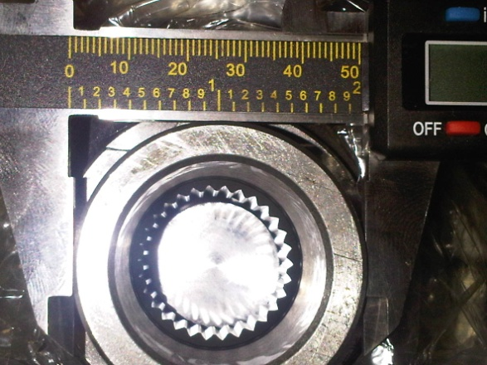
Step 10:
Oh no! old FJ40 differential has 45mm trunions. New ARB is 50mm!
You will need 50mm I.D. bearings. 20mm wide and 80mm O.D.
Koyo # 32010XU
Timken # x32010x &
Nachi: 50KB831LT & 50KB801

Slide 12
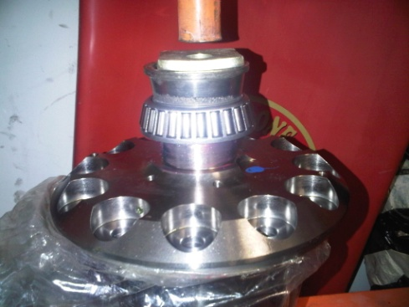
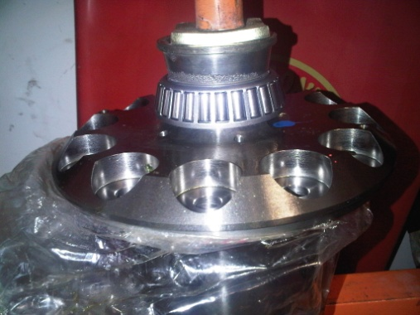
Step 11: Press new bearings onto ARB
Lightly grease the trunions and press or tap the new bearings on all the way.
Flip differential and repeat. Be careful not to damage the cage on the lower bearing. (Don’t press against it.)

Slide 13
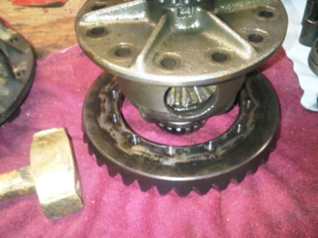
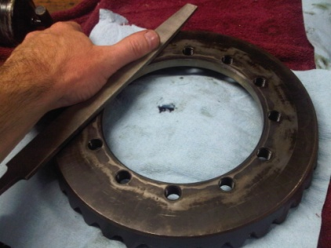
Step 12: Move Ring Gear to ARB
Undo the 19mm bolts holding the ring gear to the old differential carrier.
Use a file to check the back of the ring gear for any burrs. Do the same on the ARB flange. This makes sure nothing stops the ring gear from laying FLAT on the ring gear flange of the ARB.

Slide 14
Step 13: Mount Ring Gear
Heat ring gear to 120-200 degrees F. Do not use an open flame. I use a thrift store toaster oven after wrecking the wife’s with smelly gear oil.
Use gloves to handle hot ring gear. Drop gear onto ARB. Try to line up the holes.
Install a few bolts to make sure you can get them all in the holes and let the diff cool a bit.
Using Locktite #262 (red) Install ring gear bolts and torque to 74-79 foot-pounds. Use a star pattern because that’s just good form.

Slide 15
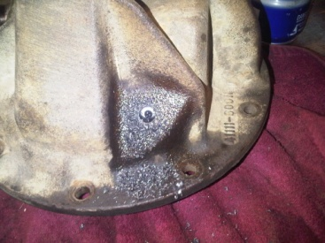
Step 14: Drill housing
Think about what you are about to do. Is this a high pinion differential or a low pinion diff?
The ARB manual indicates the perfect spot to drill the FJ40 differential housing for the air actuator line.
Protect the pinion bearing from metal chips as best you can. A dollop of grease on the inside of the hole might help catch chips too.
Drill a 7/16ths hole perpendicular to the flat spot on the differential housing. Go slow. Take your time.

Slide 16
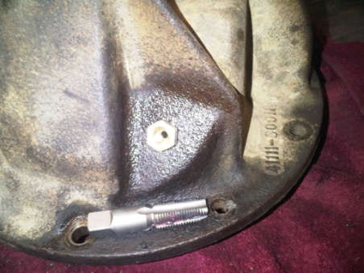
Step 15: Tap Hole for Bulkhead Fitting
Use a ¼” NPT tap
Grease the grooves on the tap to catch chips.
Try to line up the tap with the hole. Start out crooked and you’ll regret it.
Grandpa Bob says, “Start out slow and back off from there.” Take your time. Back it out when it gets tight, clean the chips from the tap often. Use a good, sharp tap.

Slide 17
Step 16: Put Differential Carrier in Housing
With the bearing races installed and lightly lubed with 90wt, set the carrier into the housing.
Tougher than it looks to keep the bearings in the races, eh?

Slide 18
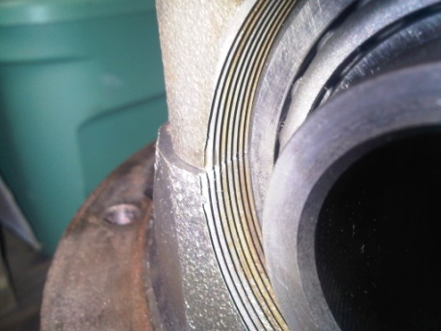
Step 17: Install bearing caps
Put the right cap on the right side
Use the carrier bolts to help line things up.
Confirm the threads “make sense.”
Carrier bolts still loose, carefully thread in the non-ring gear side adjuster and use the ARB adjuster on the ring gear side. Lightly grease the threads to make things easier.

Slide 19
Step 18: Set Backlash and Pre-load
More than one way to do this. The ARB manual even deviates from the factory service manual. The goal is to use the side adjusters to create a very small gap between the ring and pinion.
Make small adjustments to the adjuster rings and test often. Tap the bearing cap to get the race to move. Once you get the backlash right, start adding carrier bearing preload by over-tightening the adjustment rings without altering the backlash. Set the backlash where you found it before you took things apart. .006-.009”
Add about 10 inch-pounds to the pinion preload you measured as the target resistance measured at the pinion nut.
(in mini-truck world, we often go over the factory spec on carrier pre-load to combat ring gear deflection due to housing flex.)

Slide 20
Step 19: Install bulkhead fitting
Teflon tape, screw it in. No big deal.

Slide 21
Step 20: Install the ARB Air line
Using plenty of 90wt, installthe “o” rings into the grooves of the carrier. Rotate the carrier as you install it to avoid twisting the o-rings.
Twist an o-ring and your locker won’t work very long.
Line the center groove up with the lockring keeper groove.
Install the wire retainer for the o-ring carrier.

Slide 22
Step 21: Route Copper Air Line
The goal is to get to the bulkhead fitting without kinking the tube and without putting any pressure on the o-ring retainer. Big smooth loops are the trick.

Slide 23
Step 22: Cut off the extra copper pipe
Use a pipe cutter to avoid getting chips down the tubing.

Slide 24
Step 23: Connect Tube to Bulkhead Fitting
Compression fitting. You only get one shot so get it right the first time.

Slide 25
Step 24: Bench Test the Locker
90PSI: Nothing should leak.

Slide 26
Step 25: Re-install Differential
This is a c clip differential and I don’t know much about it except that it is a big pain in the butt. Experts chime in here.
Something like: Remove the center block retainer using the special ARB tool, put the axles in, put the block in, put the retainer pin back in, find the tightest c-clip that you can still get in there and use that one.
Hook up your air supply line, fill with oil and go test.

